Slide 1
ELECTRIC STOVE CONTROLLER APP
DESIGN THINKING PROJECT
GROUP 7

Slide 2
TABLE OF CONTENTS
01 INTRODUCTION
02 DESCRIPTION
03 DESIGN THINKING PROCESS
04 PROTOTYPE VIDEO
2.1 PROBLEM
2.2 SOLUTION
2.3 TEAM WORKING
3.1 EMPATHIZE
3.2 DEFINE
3.3 IDEATE
3.4 PROTOTYPE
3.5 TEST

Slide 3
1.0 INTRODUCTION
One of the problems that is possible to happen is people tend to forget that they are cooking using the stove and leave the house unattended without being aware of it.
To prevent this kind of disaster from happening, our group suggests that we create a user-friendly application that allows users to control their electrical stove using their mobile phones with ease.

Slide 4
2.0 DESCRIPTIONS
2.1 PROBLEM
Most people will forget to turn off their stoves before leaving the house. This action could lead to a disaster. For instance, a short circuit could happen if food overflows and spills onto the stove’s electrical components. Besides, leaving the stove on for too long while it is unattended by people is also a waste of electrical energy and money.
2.2 SOLUTION
Create an application that connects both the stove and the mobile phone. People can control the stove easily with just a few taps. This application will contain main functions and sub-functions that can assist users in their daily lives.
2.3 TEAM WORKING
Our group consists of 5 members and each member is assigned to different tasks that need to be done. We had our discussions both physically, which were at n28 and online through WhatsApp and Google Meet.

Slide 5
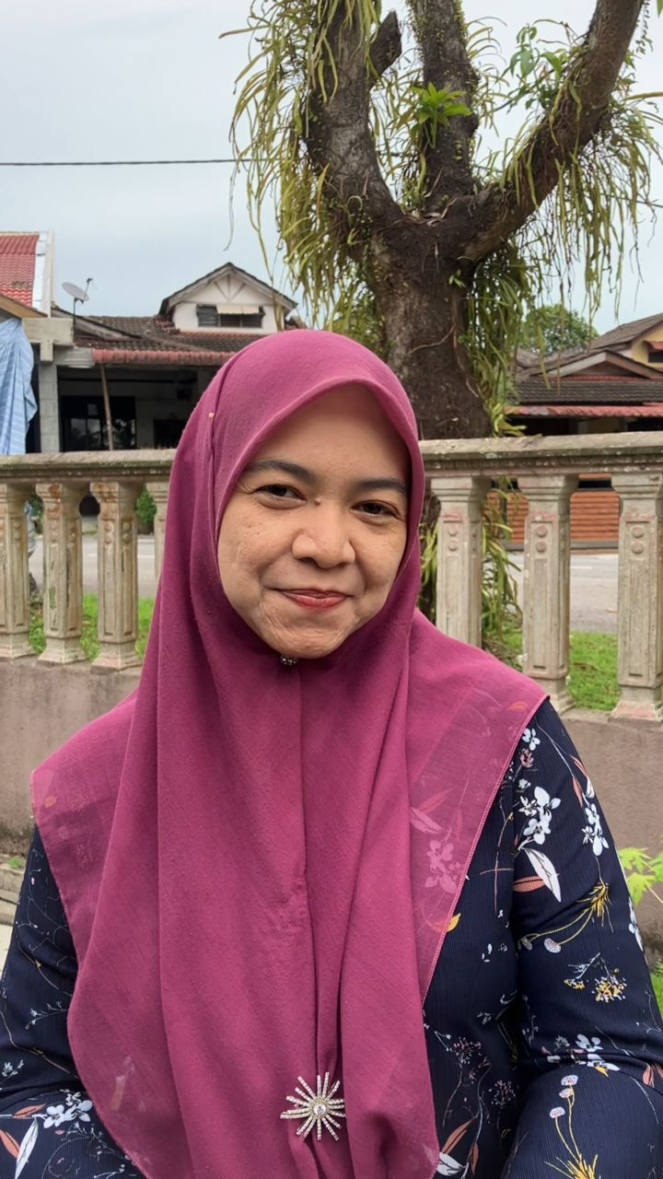
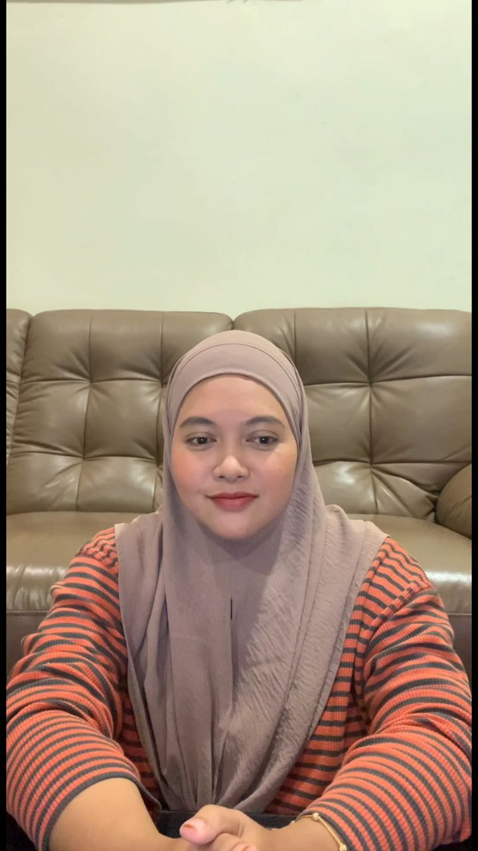
3.0 DESIGN THINKING PROCESS
3.1 EMPATHIZE
We conducted interviews and kept a journal to understand user needs. We asked about cooking habits, stove safety concerns, and control interface preferences. Our target user is someone with specific emotional and practical needs related to stove usage such as housewife and student.
Interviewee : Housewife(left) , Teacher(right)

Slide 6
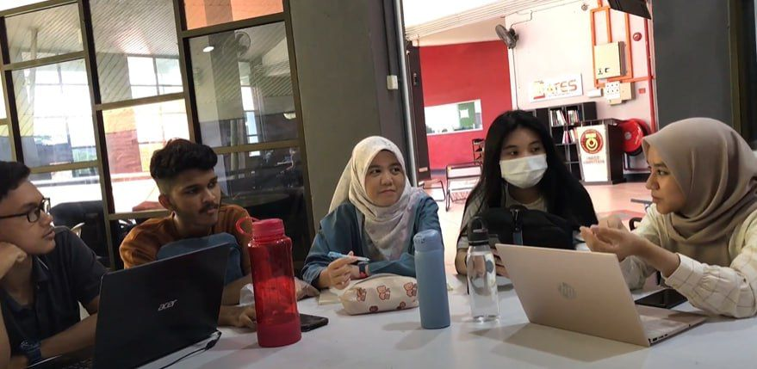
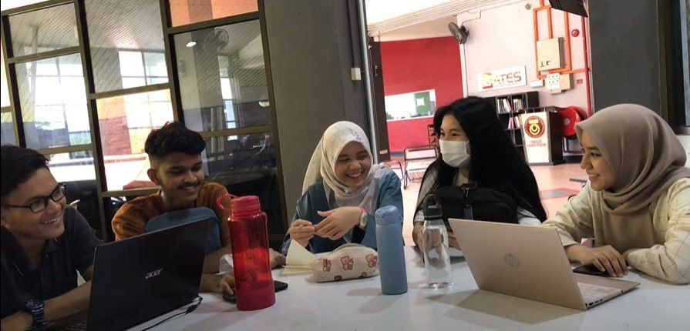
3.0 DESIGN THINKING PROCESS
3.2 DEFINE
After having the interviews, we are able to analyze the needs of our targeted groups through the information and data provided by them. This step is important in order to create a solution that can solve the problems faced by them.
Having discussion at N28 Student Lounge

Slide 7
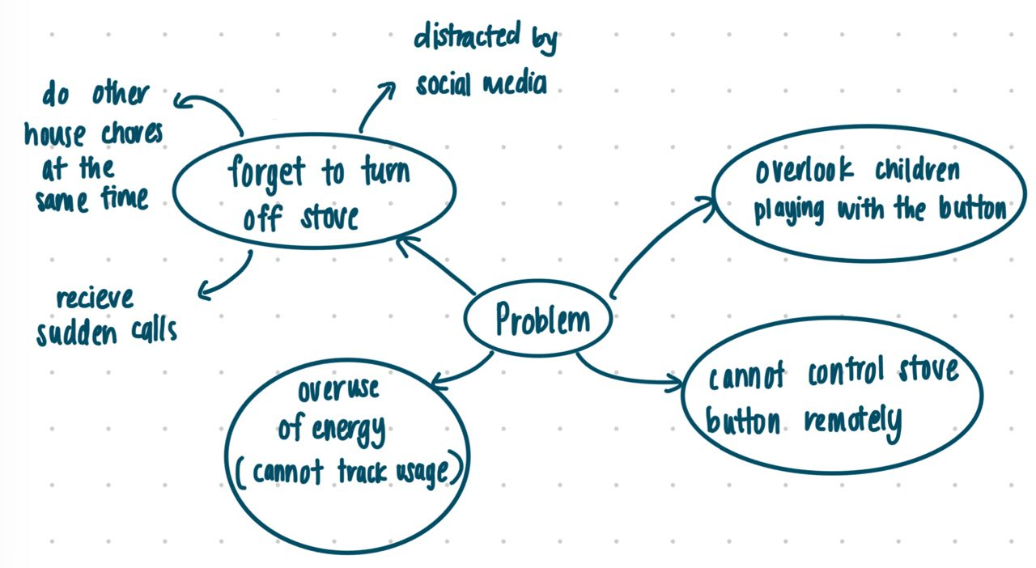
3.0 DESIGN THINKING PROCESS
3.3 IDEATE
We also have brainstorming sessions that generate a multitude of ideas to address the defined problem. Our team utilizes various ideation techniques, such as mind mapping and brainstorming workshops, to explore creative solutions and ensure a diverse range of perspectives.
Mind map (Defining Problem)

Slide 8
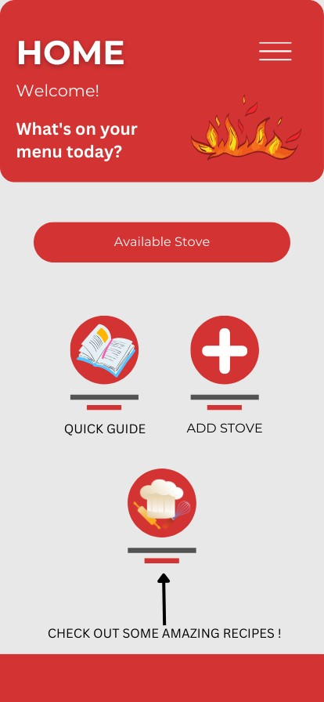
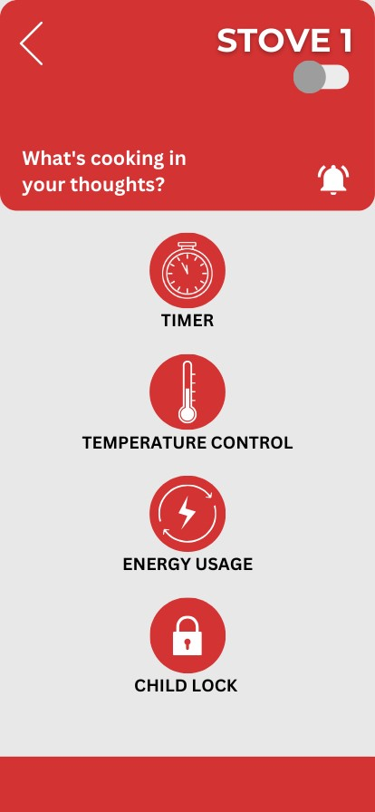
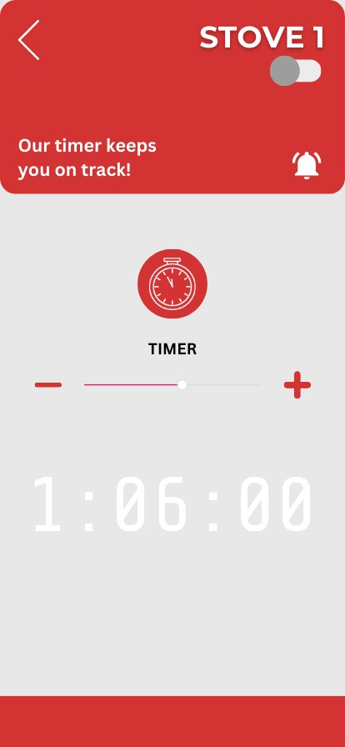
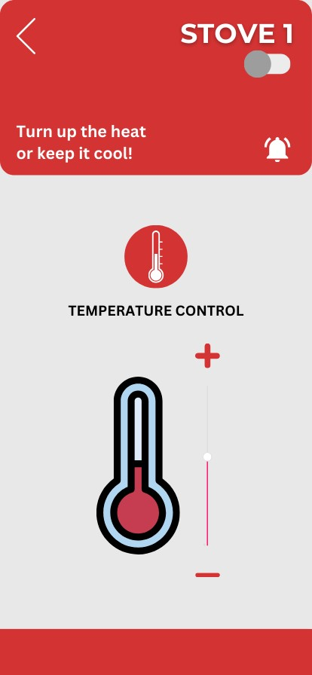
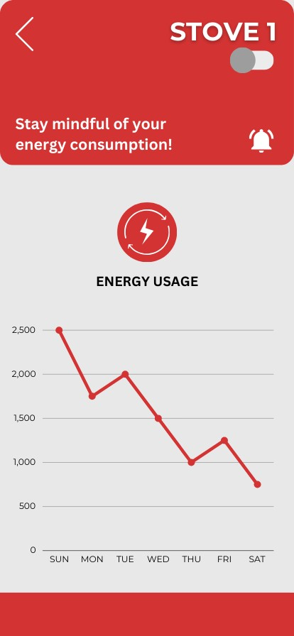
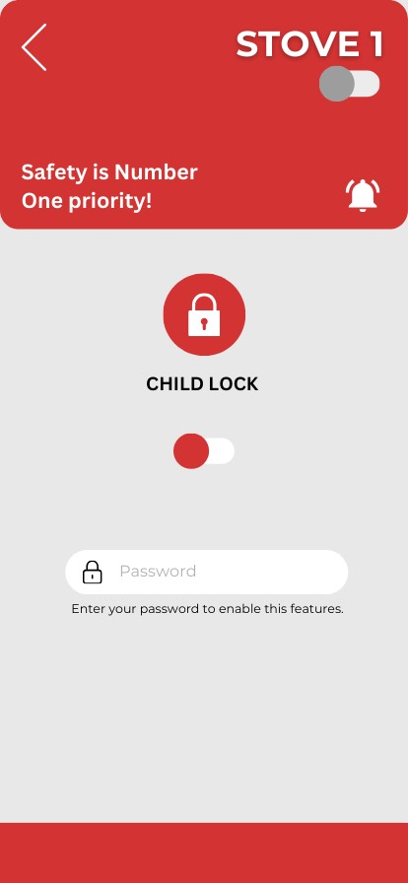
3.0 DESIGN THINKING PROCESS
3.4 PROTOTYPE
Prototype Model
After collecting the data and suggestions from our interviewees, we created a prototype using CANVA. In this prototype, it also includes the functions as a timer, temperature controller, energy usage and lastly child lock. Besides, we also add another feature which is “ Recipes ” that provides different kinds of food recipes to the users.

Slide 9
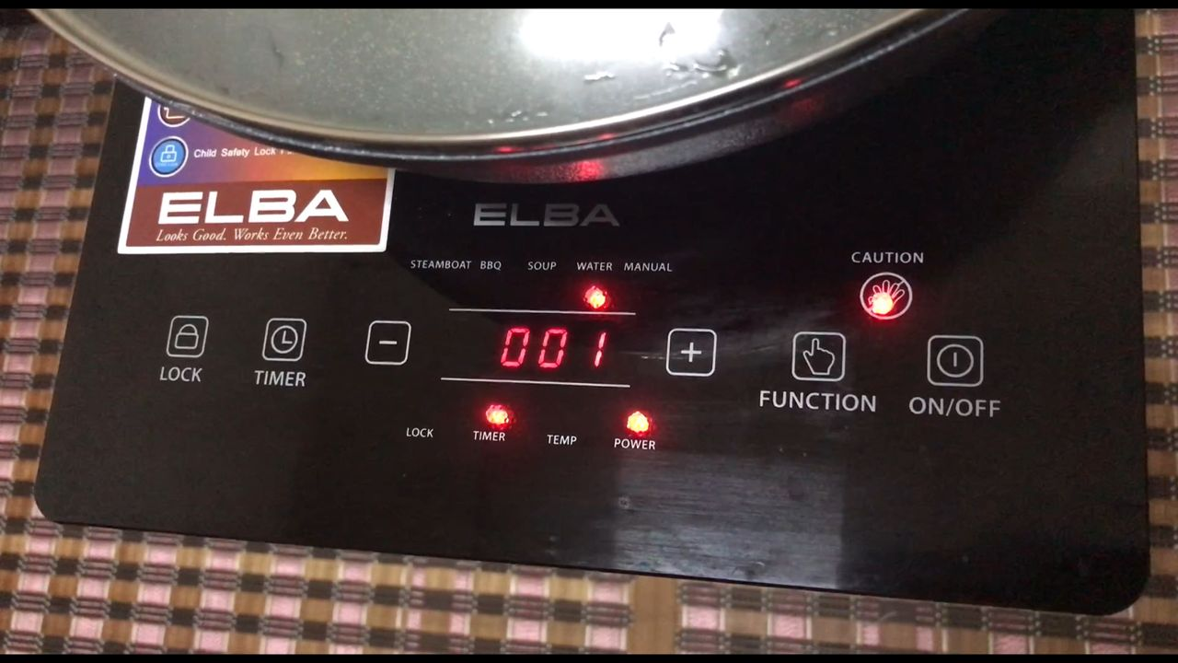
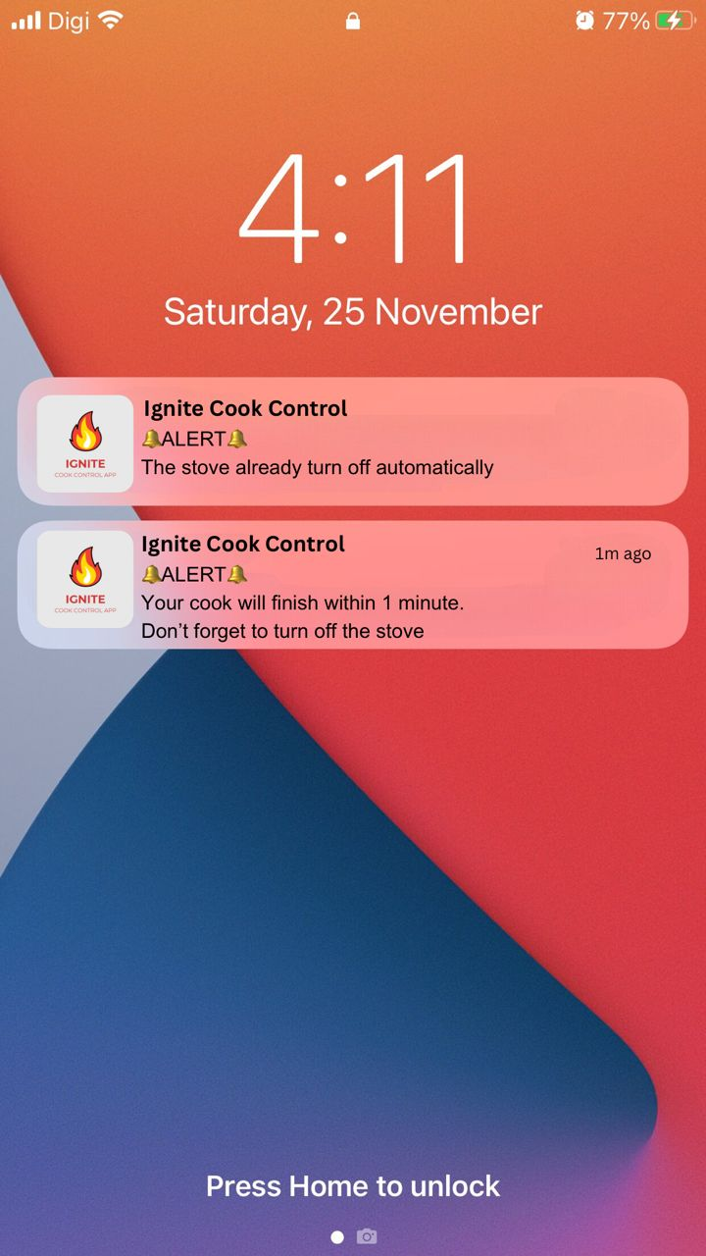
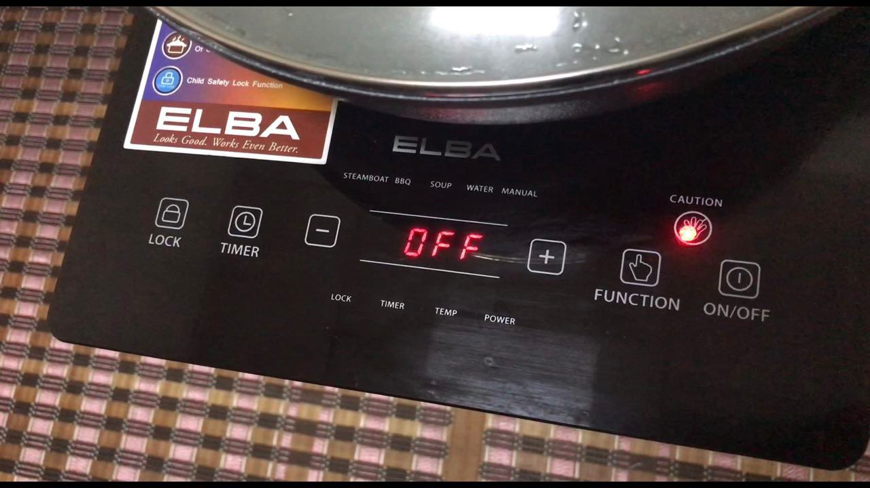
3.0 DESIGN THINKING PROCESS
3.5 TEST
Lastly, we tested our prototype with a few users. Through this testing phase, we received a few comments and also feedback regarding our prototype which allows us to modify and improve our prototype.
Testing Alert

Slide 10

Let’s take a look at our PROTOTYPE !

Slide 11
THANK YOU!
GROUP MEMBERS :
ADRIANA MUNIRAH BINTI ADIEKHASMADMAJAR
LEO MIN XUE
NIK BALQIS BINTI NIK JEFRY
BHARATH RAJ A/L MANIVANNAN
MUHAMMAD KHAIRUL HAKIMI BIN MOHD KHALID

